Slide 1


„Foundation „Aktywni XXI”
It’s easy to teach if
you know how
Kickoff meeting
19th – 20st of October 2016
Jelenia Gora – Poland

Slide 2
„Foundation „Aktywni XXI”
Foundation has been working since 2010.
Main aims - promote lifelong learning.
Target groups:
- active seniors
- retired seniors
- disabled people

Slide 3
„Foundation „Aktywni XXI”
LOCAL OWN ACTIONS
PROJECTS:
LLP:
Senior Volunteering Projects

Slide 4
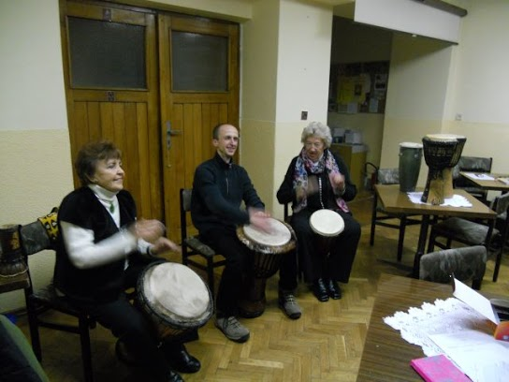
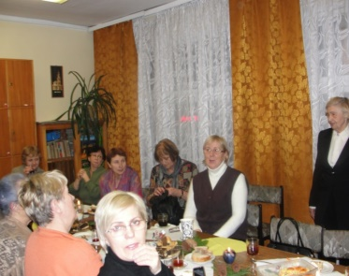
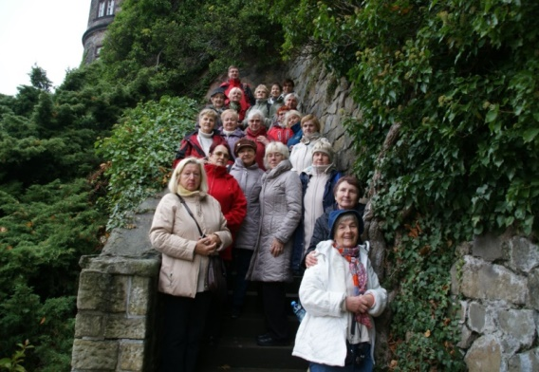
„Foundation „Aktywni XXI”
LOCAL OWN ACTIONS
workshops
lectures
language courses
tours

Slide 5
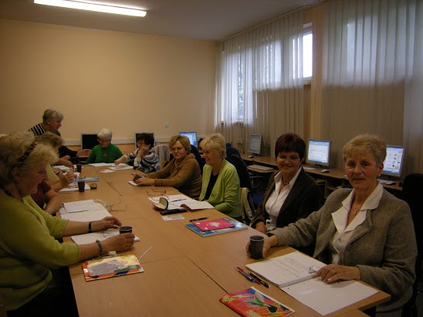
„Foundation „Aktywni XXI”
Activation, motivation, integration
In the project there were organized foreign language courses (English and German) and personal development workshops for 15 disadvantaged people.

Slide 6
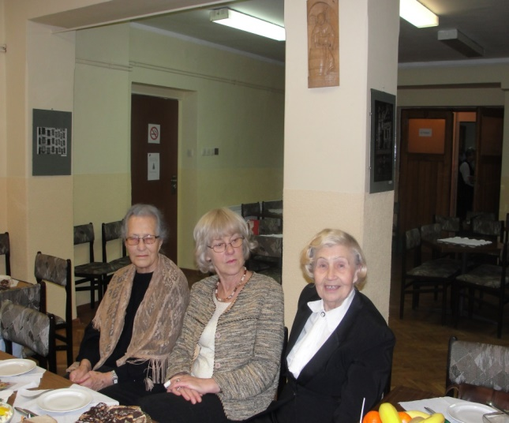
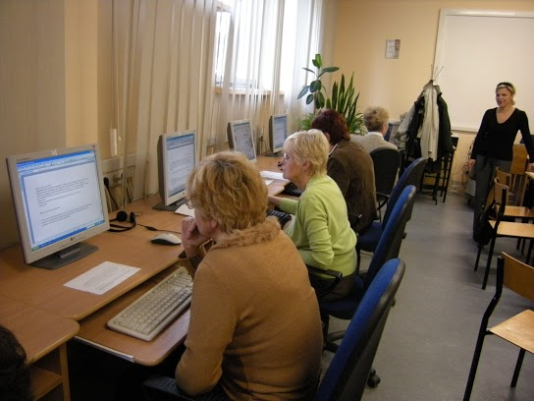
„Foundation „Aktywni XXI”
Development and work despite disability
The project implemented the following activities:
• group meetings with people with similar experiences,
• individual consultations with a counselor,
• meetings with experts who will provide current information about rules of taking a job
• computer courses

Slide 7
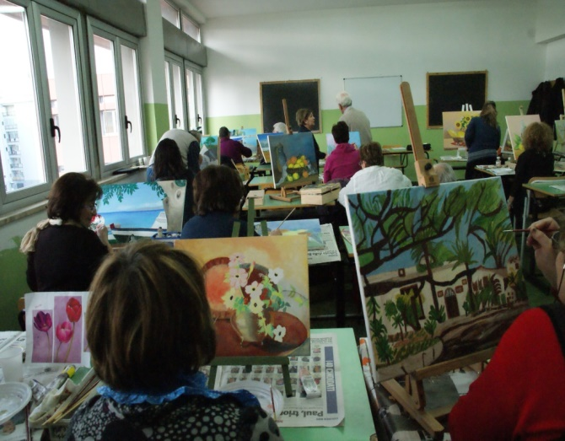
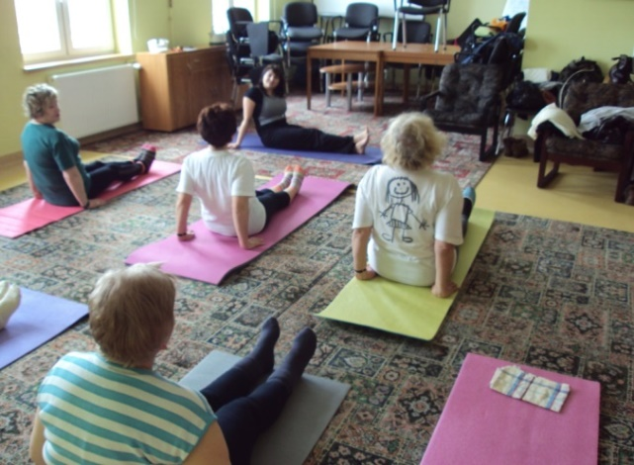
„Foundation „Aktywni XXI”
An active senior – the XXI century silver
It was created to improve the quality of education
of the elderly by increasing the diversity
of educational classes at the Seniors University,
as well as increasing the frequency of seniors
meetings. The participants were 33 people who
used new forms of activity within the Seniors University: activities in the field of information technology,
personal development workshops,
healthy lifestyle workshops
and art therapy.

Slide 8
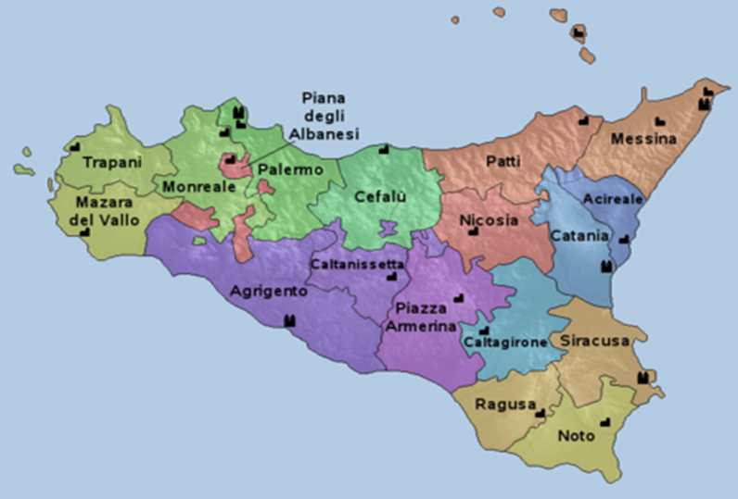
„Foundation „Aktywni XXI”
“Enduring life! Enlivening aged colours”
Together with AUSER Messina Foundation
and LUTE Milazzo from Italy,
we take part in the Grundvig project titled
“Seniors’ Volunteering”

Slide 9
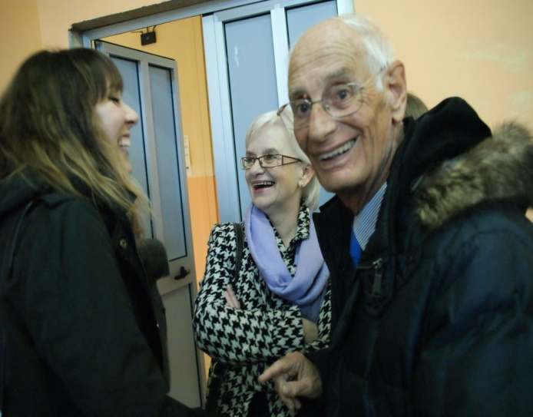
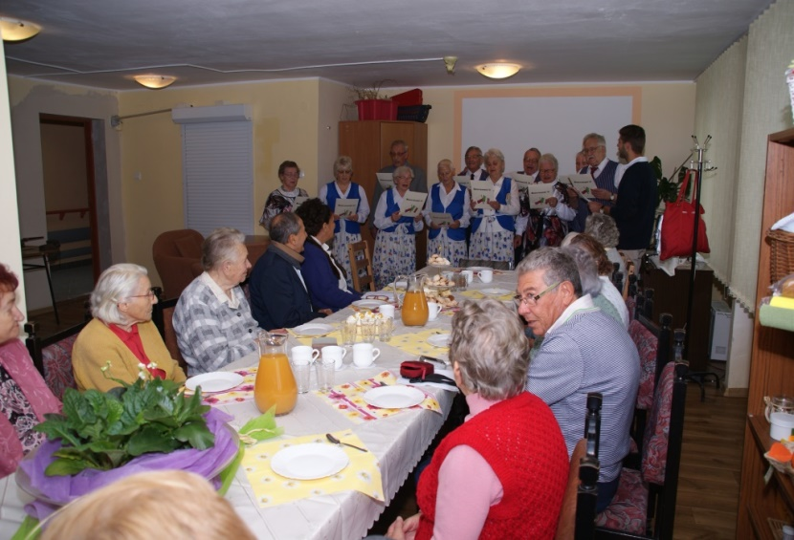
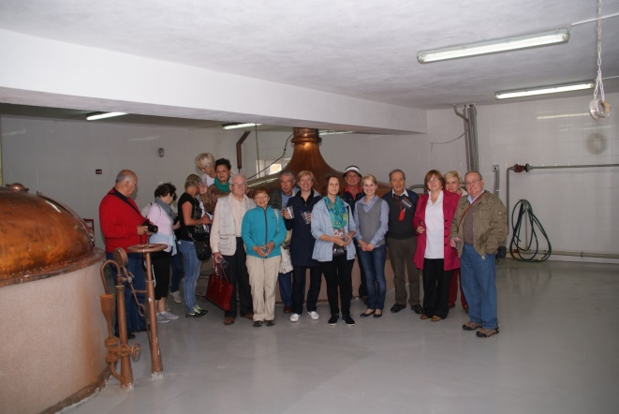
„Foundation „Aktywni XXI”
E.LI was a project that permitted
at 12 volunteers to have a cultural exchange with a European country.
Seniors from our Foundation took
part in the exchange of seniors from LUTE Milazzo. They worked together
as volunteers, learn languages,
they take part in workshops

Slide 10
„Foundation „Aktywni XXI”
New project
It’s easy to teach if
you know how
Hand and Hand – libraries and adult educations centres for lifelong learning
The Active in Europe

Slide 11
„Foundation „Aktywni XXI”
Thank you for you attention!
Contact details
Wolności 29, 58-500 Jelenia Góra, Poland
www.aktywni21.org.pl

